Slide 1

NEW MEDIA DRIVERS LICENSE
Digital Strategy Workbook

Slide 2
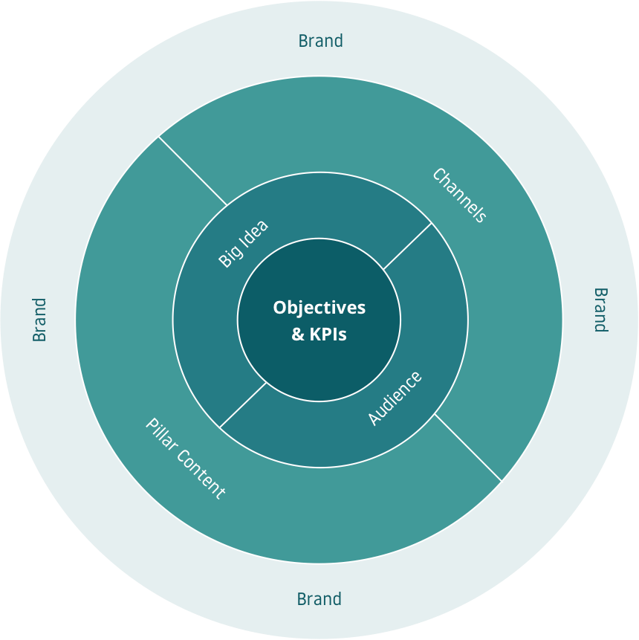
Elements of a digital strategy

Slide 3
What are the campaign objectives?
You must first identify what you’re trying accomplish. These should be written as SMART objectives, i.e. Specific, Measurable, Actionable, Relevant and Time bound. Identify one primary objective and two secondary. Make sure the written objectives include all aspects of the SMART structure.
Primary Objective | Increse Followers on social media by 50% within a year
Secondary Objective | Increase our websites visitor by 40% in a year
Secondary Objective | Increase customers who buy our food by 30% within a year

Slide 4
How will you measure success?
Every objective needs one or more key performance indicators to measure success. These are the metrics used to track campaign performance. For each objective, identify one or more KPI.
Objective | Key Performance Indicator
What objective does this relate to? | How can you measure performance towards this objective?
Increse Followers on social media platform by 50% within a year | How many followers you have on your social media compare to last month
Increase our websites visitor by 40% in a year | How many people visit your website in a month
Increase customers who buy our food by 30% within a year | How many people order food from your restaurant per month (either online or not)

Slide 5
What’s your “Big Idea”
Successful campaigns need a unifying theme and message that resonates with your target audience, we call this the “Big Idea.” Brainstorm a list of possible big ideas for your brand, then identify the top five. Reduce that list to the top three… finally, pick the strongest idea for your campaign.
MAKE A LIST
1 | Home is where we at
2 | Make Fried rice with real Kung Fu
3 | Fried rice for everyone
4 | Here is the golden age of Fried rice
5 | Authentic equals the best
6 | Fry it just the way you want
7 | Time changes, Fried rice remains classic
8 | Fight for your taste
9 | This is what tradition tastes like
10 | Authentic, all in it
11 | A little more sauce for you only
12
13
14
15
PICK THE TOP 5
1 | Fried rice for everyone
2 | Fight for your taste
3 | Fry it just the way you want
4 | This is what tradition tastes like
5 | Here is the golden age of Fried rice
REDUCE TO THE TOP 3
1 | Fight for your taste
2 | Here is the golden age of Fried rice
3 | Authentic equals the best

Slide 6
Insert
Picture
Who do you champion?
1a
Create buyer personas for your ideal target audience.
PERSONA #2
Name: Weijie Zhang Persona type: Chinese student study in America Background: Write a short 1 - 2 paragraph summary of who this individual is and where they are in their life… Weijie Zhang is a student of MSU major in media and information. Like many other Chinese students Who study abroad, Weijie is seeking for authentic Chinese food, especially fried rice East Lansing is a small city, although there are many Chinese restaurant here, but none of them make good Fried rice. He wants to find taste good Fried rice in East Lansing. | Attributes: Age:21 Gender:Male Education:Junior, Media and Information Location:East Lansing Occupation:Student
What problem does this persona have? -He wants authentic Chinese Fried rice -He wants to taste it in East Lansing How do you help solve it? -Provide good authentic Fried rice -open up a store in East Lansing What does this persona care about? -The taste of the rice -weather it is authentic, traditional or not. Where does this persona spend their time online? -Wechat -Weibo -Instagram | “I really want to taste authentic Chinese Fried rice in East Lansing…”

Slide 7
Insert
Picture
Who do you champion?
1a
Create buyer personas for your ideal target audience.
PERSONA #2
Name: Emily Nichols Persona type: News editor Background: Write a short 1 - 2 paragraph summary of who this individual is and where they are in their life… Emily Nichols is an editor working for local newspaper in Chicago. She loves Chinese food, but most of the nice decorated Chinese restaurants are expensive. She wants to taste different kind of Chinese food while saving her money. Also, she want something authentic. | Attributes: Age:26 Gender:Female Education:College graduate, business major Location:Chicago Occupation:Editor
What problem does this persona have? -She wants to taste various type of Chinese food -She wants the food to be less expensive -She wants the food to be authentic How do you help solve it? -Open stores in Chicago -Provide Fired rice in suitable price -Provide authentic Fried rice What does this persona care about? -How much the food costs -The food’s kind and weather it is authentic or not Where does this persona spend their time online? -Instagram -Facebook -Twitter | “Where can I find cheap and authentic Chinese food in Chicago?”

Slide 8
Channels: Social media
Describe the role social media will play in your digital marketing efforts. Specifically, provide a high level overview on how you’ll use social media to achieve the objectives defined earlier in this workbook. You don’t need to go into detail, such as what platforms or what content will create. A simple overview will suffice.
Social media will play the primary role in my digital marketing efforts. First, I will conduct high-quality engagement with new and old customers and influential users through social media. A friendly and enthusiastic attitude can help us build a great brand image. Second, I will post promotions, price cuts, discounts and other activities on social platforms. This can stimulate the consumption desire of customers to a greater extent. Third, I will use social platforms to build a positive online reputation, Increase regular customers and their brand loyalty. To do so, I’ll use polls, opinion boxes, customer reviews etc. Finally, I try to use social media to find possible partners. Carry out mutually beneficial cooperation between my brand and others’.

Slide 9
Channels: Paid Media
Describe the role paid media will play in your digital marketing efforts. Specifically, provide a high level overview on how you’ll use paid media to achieve the objectives defined earlier in this workbook. You don’t need to go into detail, such as where you’ll advertise, what the ads will look like, and where it will take users.
Paid media should in secondary role in my digital marketing efforts. The paid media should be focusing on social media ads and website ads. The budget will be 10%-15% of my annually operating income. Paid media is mainly used to increase the influence of my brand. For customers who haven't tried our brand yet, I’ll use paid media to get their attention, to arouse their interest, and to persuade them to try our food. I would be more inclined to make appealing ads. The best way to attract new customers is to use advertisements to arouse their feelings. For consumers who had already tried our food. We use strategic advertising to increase their brand loyalty. We use paid media to further inform them that it is better to choose us than other brands. We’ll use paid media to promote corporate values and spread our big ideas. The customer is our base, so our paid media is all made for customer or potential costomer.

Slide 10
Channels: Organic Search Engine Traffic
Describe the role organic search engine traffic will play in your digital marketing efforts. Specifically, provide a high level overview on how you’ll use search traffic to achieve the objectives defined earlier in this workbook. You don’t need to go into detail, such as what keywords you’ll target or pages / content you’ll create.
The role of organic search engine traffic in my digital marketing efforts should be in the third place. It’s not that it is not important. It should serve as a supportive methods to increase our brand awareness. I’ll use search traffic to increase the number of visitors to the website or social networking platform. Search engines use algorithms to make our social platforms more accessible to potential customers. This method is based on people’s relevant search content and interests on the Internet. So in order to increase the number of visitors, we need to fully analyze the preferences of our potential customers and then publish relevant content regularly on our social media platforms. You don’t have to pay for search engines, and they can help you reach many potential customers as possible. So, posting relevant and high-quality content on your social media platform is essential.

Slide 11
Channels: Email List
Describe the role email marketing will play in your digital marketing efforts. Specifically, provide a high level overview on how you’ll use email to achieve the objectives defined earlier in this workbook. You don’t need to go into detail, such as how you’ll grow your list, what emails you’ll send, etc...
The role of email marketing is the same as the role of search will play in my digital marketing efforts. As relatively young potential customers are not in the habit of reading emails regularly. I’ll mainly use the membership system of the restaurant, the customer review and some interesting surveys to collect people’s emails. I don’t want people to get our emails too often. I’ll send them emails when there's a new product, when there's a new store opening, when there's a promotion, or when there’s a major holiday coming. Also, responding to emails is a formal and effective way to respond to personal complaints (if any) or personal comments. Communicating via email with people of a certain age and experience can increase their trust in the brand.

Slide 12
Channels: Website
Describe the website will play in your digital marketing efforts. Specifically, provide a high level overview on how you’ll use your website to achieve the objectives defined earlier in this workbook. You don’t need to go into detail, such as what will go on your website, what it will look like, etc...
Website will play a primary role in my digital marketing efforts (same as social media). I’ll use official website to update my menu, so that customers could check it out easily anytime. I’ll also use the website to post the address of our stores in every states. The website will include links to all social media platforms, and the homepage will show major events of our brand. Finally, one of the most important functions of a website is to order food. Food delivery always make things easier for a lot of customers.

Slide 13
What Pillar Content will you create?
Campaigns need overarching themes and long form content that be broken up into smaller, distributable bites. Plan out three pieces of pillar content that you’ll create as part of your campaign.
Content headline / title | Description | Media
What are you going to call this piece of content? | Describe the content in 3 - 4 sentences. | Is this a video? eBook? Podcast? Mini-series? etc...
How to make delicious Chinese Fried rice? | This is more like a behind-the-scene documentary showing people how we make authentic Chinese Fried rice in our own kitchen. Videos like this not only show people how authentic Fried rice is made, but also build our brand image. Demonstrate the reliability and professionalism of the brand. | A video (Short documentary film)
The History of Rice | This cartoon tells the development history of rice. Show people the importance of rice in Chinese diet, the different ways of cooking rice, and the traditions and culture of Chinese food. The cartoon should be well-produced and interesting, it should have several episodes and 5min long for each. | Cartoons
Everything you need to know about Kung Fu Rice | This is a magazine that introduces our brand in all aspects. It introduces the philosophy, purpose and spirit of our brand. Introduce people our team of chefs and excellent staff. Introduce the management personnel and management mode. This magazine shows our professionalism and team spirit. Helps up in building the brand image. | Magazine

