Slide 1
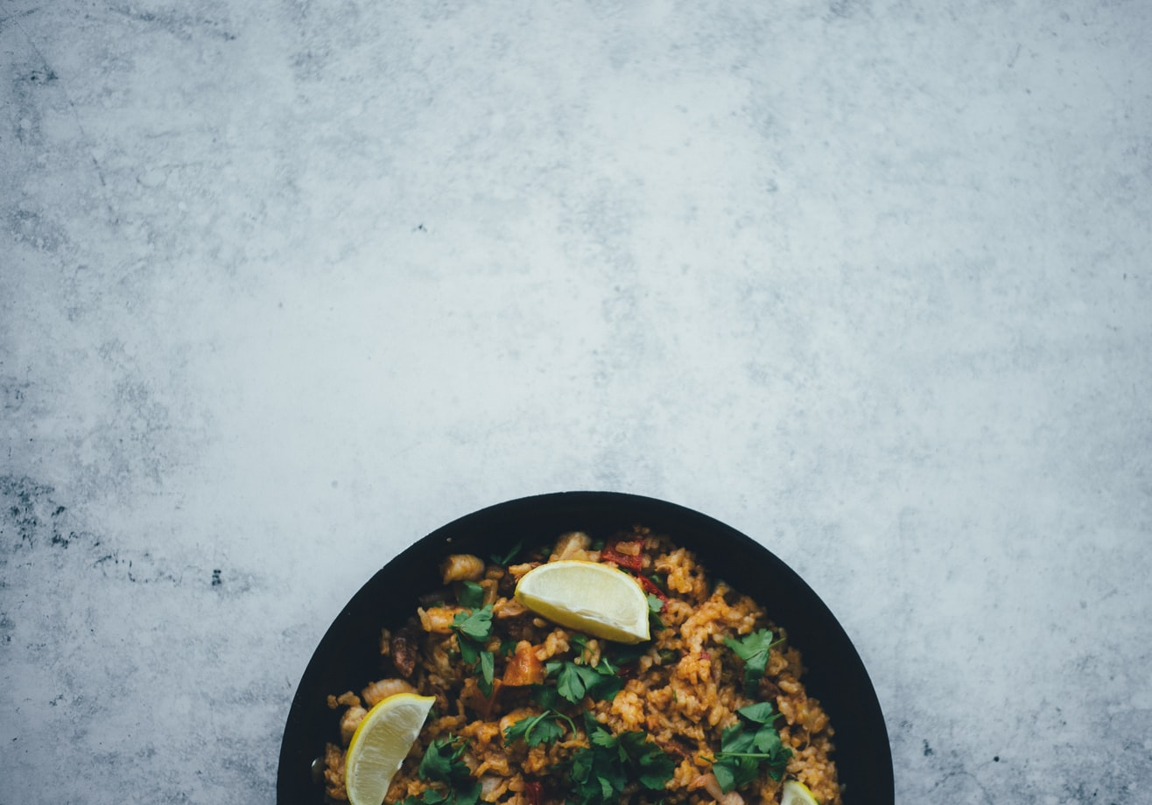
ADV 420 Final Pitch
Dengkun Feng

Slide 2
Brand Name: Kung Fu Rice
Overview: Kung fu rice is a newly established brand dedicated to making authentic Chinese Fried rice. We hope to use our professional attitude to make the most delicious rice, we hope to let foreign friends feel our enthusiasm and the charm of Chinese culture. Like our slogan, Fried Rice for all, we want to make Fried Rice that everyone loves. We fired it the way you want.

Slide 3
Brand Look: professional, creative and representative
Brand Voice: dedicated
Slogan: Fried Rice for All.

Slide 4
Campaign Big idea
“Fight for your taste!”
This big idea combines the concepts of kung fu and food together. One of the core spirit of Chinese kung fu is to fight for something meaningful. We incorporate the kung fu fantasy into our brand. We want people to feel that delicious food is worth fighting for.

Slide 5
Target Audience
Type 1: Chinese students, Asian Americans who’re craving for tasting authentic Chinese Fried rice (food).
Type 2: foreigners who love Chinese food. And want to taste authentic Chinese cuisine without spending too much money.

Slide 6
Goals & KPIs
Main goal: Build a good brand image, increase brand awareness, attract more potential customers
Primary objective: Increasing the number of followers on social media within a year.
KPL for primary objective: checking how many followers have grown over a specific period. (focus on the rate of growth as well as the number of followers.)
secondary objectives: Increase our website’s visitor by 40% in a year & Increase customers who buy our food by 30% within a year
KPL for secondary objective: Monitor how many people visit our website in a month check how many people click our website within a month & Check how many people order food from our restaurant in a month (either online or not).

Slide 7
Social Media Strategy
three main social media channels: Instagram, Weibo, and Youtube
Primarily goal for Weibo and Instagram
create at least one interesting(influential) topic and upload at least ten valuable content within a month.
Primarily goal for Youtube
Upload at least 5 short videos and 1 long video a month.
KPL: monitor traffic all the time. Check if we upload enough content and videos.

Slide 8
Social Media Strategy
three main social media channels: Instagram, Weibo, and Youtube
1)Weibo
Type of content: Posts about new menu, new food, promotions and discounts/ Links to our video/ Original content about things around the world/ Start campaign-related topics
How often: 3-5 posts a week
How will you attract followers: Engage with people often/ Post valuable content/ Start potential topics/ Build a good reputation/ Keep up with current events and trends.
Native features: Polls/ Hashtag/ Weibo stories/ Observe the most popular searches on Weibo and start topics wisely
Tone: A bit more formal than Instagram/ Friendly/ Professional.
Engage with the audience: Forward/ like/ comment/ polls/ re-post/ direct message.
2)Instagram:
Type of content: fancy, attractive, and trending Posts/ More visual aesthetic pictures or short videos/ Promote brands/ Using advertisement/ Spread a campaign message/ Build a cool brand image.
How often: 5-7 posts a week
How will you attract followers: Cool and compelling campaign message/ Interesting topics/ Creative, original content or art.
Native features: Instagram story/ Hashtag
Tone: Cool/ up to the trend/ creative/ innovation.
Engage with the audience: Forward/ like/ comment.
2)Youtube:
Type of content: Original video/ Documentaries / Comedy miniseries
How often: 1-2 videos per week.
How will you attract followers: Attract people with creative stories and excellent video productions/ Make short videos that have the potential to go viral.
Native features: Take advantage of search engines on Youtube.
Tone: Funny, Friendly, creative, interesting, humor, entertaining
Engage with the audience: Comments, reply. Normally not much of direct engagement with people since it is a video-based platform.

Slide 9
Social Media Strategy-Pillar Content
1)Content title: How to make delicious Chinese Fried rice?
Media: Video
Description: A short documentary video (film) showing people how we make great Fried rice in our Kitchen.
2)Content title: The history of rice
Media: Cartoon
Description: A series of well-produced cartoon, about 5min in total for one episode, and 5 to 8 episodes in a season. This cartoon mainly tells you everything about rice. About the origin of rice, its cultivation, and the importance of rice in Asian countries, especially China.
3)Content title: Everything you need to know about Kung Fu Rice
Media: Magazine
Description: This is a magazine that covers every aspect of our brand. This magazine introduces our brand background, brand ideas, brand spirit, brand culture.

Slide 10
Paid Ads Strategy
5 Channels:
Weibo: The basic News feed Ads. Target specific people based on their location or interest. It’s more direct and effective.
YouTube: In stream ad (video skipping ads). Attract people very fast.
Yelp: Advertisement on yelp. People search for restaurants or check reviews on Yelp will have a chance to see my brand.
Instagram: Simple image ads. Displays image to potential customers in a direct way.
Google: Search ad. Pay for specific keywords so that customers will get a chance to know my brand.
Choice of keywords: Best Chinese food, Chinese Fried Rice, Best Fried Rice

Slide 11
Inbound Strategy
Types of content：
Bruce Lee: Contents with Bruce Lee take advantage of people’s love and curiosity about Chinese kung fu, make people feel that our team is skillful and professional and give them a sense of trust in my brand.
Fried Rice Recipe: Post some simple recipes and teach people how to make Fried Rice. Engage those who are interested in traditional Fried rice. Let them cook it themselves and help them understand that we are professionals in the development of Fried rice.
How do you tell if Chinese food is authentic: Introduction of local Chinese cuisine. Using accurate descriptions of flavors to give people a comprehensive understanding of real Chinese food. So that people can use this introduction to evaluate Chinese food in the United States. Let them feel that we can make the most authentic Chinese Fried rice and attract them to try it.

Slide 12
Inbound Strategy: Content offer
1.Headline: How to make Fried Rice with real “KungFu”?
Download: An article with pictures and an introduction of how we make Fried Rice with skills.
CTA
Headline: How to make Fried Rice with real “KungFu”?
Supportive text: Want to know the secret of cooking Fried Rice? Download it!
2.Headline:When Kung Fu meets Fried Rice
Download: A PowerPoint that show the various schools of kung fu in China and the food we make inspired by these kung fu moves
CTA
Headline: When Kung Fu meets Fried
Supportive text: Unique Fried rice inspired by Chinese Kung Fu.

Slide 13
Inbound Strategy-Follow up
Follow up emails
1)Hi, this is Kung Fu Rice. I appreciate that you took your time to get to know about our brand. Did you get what you’re looking for so far? Well, if you need more information about our brand, our websites and social platforms are always there for you to explore. However, I have to say that the best next step is to come to the store and try our new food! The Kung Fu Kitchen is always open for you. Fight for your taste!
2)Hi, this is Kung Fu Rice. It’s been quite some time since you get in touch with us. I know work and life might be overwhelmed sometimes! You need a reminder, a reminder such as hot soup, cold soda, or…ahh, Fried rice made with real “Kung Fu”! I hope we meet you again. I know you miss us!
3)Hi, this is Kung Fu Rice. I’d like to know how you’re doing in finding the right Chinese food. If you haven’t found a restaurant that fits your taste, maybe you should check our website and get to know more about us. I’m always here for you if you have any questions. We’ll fight for your taste together!
Follow up offer:
We will first send a link to the customer’s email. By clicking the link, they will enter a website that shows our menu. After that, the customer can choose two types of fried rice, drinks, and desert that they want to try. After the selection, the system will generate a QR code. Whenever they come to any Kung Fu Rice store in the United States with this QR code, they can eat their choice of food for free.

Slide 14
Sample Content
1) Sharing the Fried rice you cook
Headline: Who’s the best-Fried rice cooker?
Summary: After posting some recipes to social media, we encourage people to follow the recipe and cook Fried rice themselves. And after that, they can share their Fried rice’s picture on social media with a hashtag of this topic. Those who got lots of likes will have a chance to get a special discount from our brand.
2) Authentic Chinese food introduction
Headline: The only guide you need when choosing Chinese food.
Summary: A comprehensive introduction to local Chinse cuisine, help people to evaluate Chinese food in the U.S so that they know which is more authentic.
3) Artist Challenge
Headline: Bruce Lee drawing challenge
Summary: This topic mainly focuses on artists and painters(especially on Instagram), encourages them to create Bruce lee paintings and share them on social media. People who get more likes have the chance to get our brand’s annual membership

Slide 15
Budget Breakdown (budget within a year)
Ads
Weibo: 45,000$
YouTube: 14,000$
Yelp:55,000$
Instagram:60,000$ Google: 30,0000$
Total: 500,000$
Production:
cartoon series: 100,000$
TV Miniseries: 200,000$
Documentaries: 300,000$
Short Videos: 200,000$
Total: 800,000$
Design:
PPT/ Magazine/Article: 10,000$
Website design: 10,000$
Others:20,000$
Total: 40,000$
Crew
Social media management: 50,000$
Traffic monitor: 20,000$
Content analyze: 30,000$
Website management: 20,000$
Total: 120,000
Total Budget for all campaign activities and production: 1,500,000$

Slide 16
Summary
In fact, in general, my various strategies are aimed at younger people. I have invested a lot in social media and design. Also I put a lot of money in making videos or tv series. Because I think media such as TV, movies, videos, documentaries are combination of sound and motion, it can arouse people's emotions more quickly. In my observation, for people in the 21st century, identifying with a brand's culture takes precedence over identifying with a brand's products. For people today, they need more than mere sensory stimulation. They find a sense of identity, a sense of belonging through the brand. Through the brand to distinguish, through the brand to show their different or the same. People's complex feelings towards a brand are always greater than the products created by the brand itself. Therefore, to build a successful brand, we need to attract and impress a group of people in all aspects. Although what we make is food, but we want people to love Kung Fu Rice not just for our taste. We want them to love us more than food itself, but for the feel of the brand, as it represents something they identify with and like.

